Slide 1


Trident Techlabs - Entrepreneurial Analysis
Section A - Group 1
Done By: Section - A , Group 1
Devika O Nair (IIT2022001)
Sugam Sareen (IIT2022002)
Jatin Soni (IIT2022003)
Vatsa Bhuva (IIT2022004)
Jai Khanna (IIT2022005)
Saketh (IIT2022006)
Samuel (IIT2022007)
Shashank (IIT2022008)
Aashish Raghav (IIT2022010)
Aditi Gupta (IIT2022011)
Keshav Lohani (IIT2022012)

Slide 2
Purpose, Vision, Mission
Purpose:
Provide innovative, reliable technology solutions that drive efficiency and advancement in engineering and power systems.
Vision:
To be a trusted leader in engineering and power systems technology across industries, enabling smart, sustainable solutions that meet modern needs.
Mission:
Foster sustainable growth in power management by providing reliable, future-ready solutions to utilities and industries.

Slide 3
Values and Philosophy
Values:
Innovation: Commitment to continuous improvement and cutting-edge solutions.
Integrity: Operate with transparency, ethical standards, and respect for stakeholders.
Customer Focus: Prioritize client success and satisfaction through tailored solutions.
Quality: Adherence to high standards of performance and reliability in all services.
Philosophy:
Collaborative Growth: Believe in growth through partnerships, shared expertise, and long-term client relationships.
Sustainable Impact: Drive forward-thinking solutions that support environmental and economic sustainability in power and engineering sectors.

Slide 4
Leadership Profile - Trident Techlabs
Chairman:
Sharad Naithani
Founder and visionary leader with over 25 years in technology and engineering solutions.
Strategic focus on company growth and market positioning.
Core Management Team:
VP of Engineering: Focuses on innovation and quality across engineering projects.
Head of Power Systems: Drives strategic initiatives in power and utility solutions.
Director of Client Relations: Prioritizes customer service and tailored solutions, fostering long-term partnerships.
CEO & CFO:
Sukesh Chandra Naithani
Oversees both financial and operational aspects of the company.
Experienced in finance and engineering management, driving fiscal growth and operational efficiency.
Managing Director:
Praveen Kapoor
Expert in engineering solutions and project execution.
Leads client relationships and service delivery to ensure high standards and customer satisfaction.

Slide 5
Products, Brands, Geographies and Customers
Products:
Engineering Solutions: System design, PCB & embedded solutions, electromagnetic simulations.
Power System Solutions: Smart grid tech, power management, renewable integration tools.
Geographies:
India (Headquarters): Nationwide presence, with expansion in Asia-Pacific regions.
Global Reach: Projects and partnerships across North America and Europe.
Brands:
Trident Techlabs: Core brand for engineering and power systems.
SmartPower Solutions: Specialized offerings for power distribution utilities.
Customers:
Industries Served: Aerospace, Defense, Automotive, Telecom, Power Utilities.
Key Clients: Major engineering firms, public utilities, and OEMs (Original Equipment Manufacturers).

Slide 6
Market Share & Revenue
Market Share:
Engineering Solutions: Holds a competitive position in India’s engineering services sector, with a focus on high-growth industries like aerospace, defense, and telecommunications.
Power System Solutions: Recognized for smart grid and power management solutions, with a growing presence in renewable energy integration.
SME Platform: Listed on NSE’s SME platform in 2023, gaining visibility and investor interest.
Revenue Highlights:
FY 2022-2023 Revenue: ₹6.82 crore
7M FY-2024 Revenue: ₹2.10 crore
Revenue Growth: 128.4% increase compared to the previous year, reflecting strong market demand and expanded client base.
IPO Proceeds: Raised ₹16.03 crore from its 2023 IPO, boosting capital for R&D and market expansion.

Slide 7
Profitability and Financial Health
Profitability:
FY 2022-2023 Profit After Tax (PAT): ₹5.54 crore
7M FY-2024 PAT: ₹2.66 crore
Profit Growth: PAT surged by 760.3%, indicating efficient cost management and higher-margin projects.
Profit Margins: Reflects increased operational efficiency and a shift toward higher-value offerings.
Financial Health:
Investment in Growth: IPO funds directed toward R&D, product enhancement, and geographical expansion.
Sustainable Profitability: Focus on long-term profitability through innovation and client retention strategies, securing repeat business and industry partnerships.

Slide 8
Competition
Key Competitors:
Engineering Solutions: Competes with L&T Technology Services, Tata Elxsi, and HCL Technologies in the fields of system design, PCB solutions, and embedded systems.
Power Systems Market: Faces competition from ABB India, Siemens, and Schneider Electric in smart grid and power management sectors, especially with renewable energy integration.
Competitive Edge:
Niche Expertise: Specialized in both engineering and power solutions, which differentiates Trident Techlabs in a crowded market.
SME Focus: Smaller, agile structure allows for personalized client solutions and faster innovation cycles.
IPO-backed Expansion: Recent public listing supports its growth into high-demand sectors with boosted capital for R&D.

Slide 9
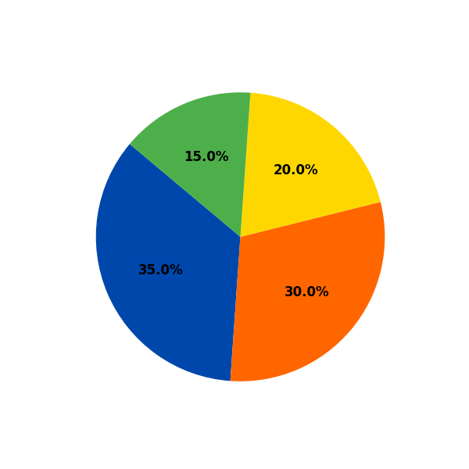
Organization Structure & Company Spread
Structure:
uses a flat organizational structure for open communication and collaboration.
Key Departments:
Product Development (35%): Innovates solutions and technology.
Marketing & Sales (30%): Manages brand and client engagement.
Customer Support (20%): Ensures user satisfaction.
Human Resources (15%): Handles recruitment and training.
Company Spread:
Market Presence:
Operating in 15 countries with 500 clients, Trident Tech Labs has grown its market reach by 25% in the last year
Growth Strategy:
Targeting emerging markets in Southeast Asia and Africa, with 30% annual growth in tech adoption.

Slide 10
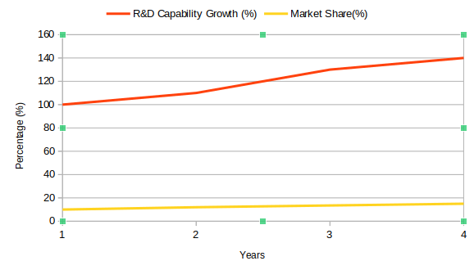
Recent Mergers & Acquisitions
Strategic Acquisitions:
Acquired Tech Innovations Inc. for $15 million and
merged with Cloud Solutions Ltd. for $10 million.
Growth Impact:
Expected 40% boost in R&D capabilities, increasing
market share from 10% to 15%.

Slide 11
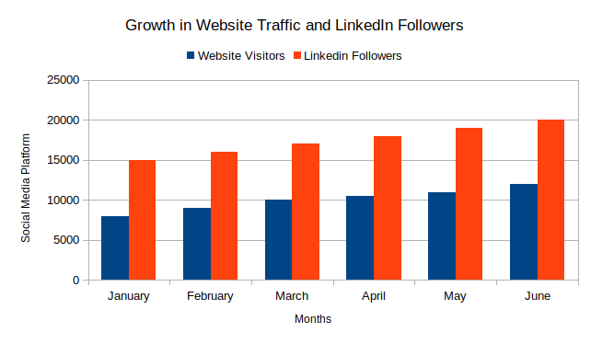
Assessment of Social Media Platforms
Website:
Average of 10,000 visitors/month with a 30% lead conversion rate.
LinkedIn:
200% increase in followers to 20,000; achieving 10,000 impressions/month.
Engagement:
Campaigns on Twitter and Instagram resulted in a 150% increase in interactions.

Slide 12
Overall Observations
Strengths:
Unwavering Commitment to Innovation: Trident Tech Labs boasts an impressive 90% customer satisfaction rate, reflecting our dedication to delivering cutting-edge solutions that meet and exceed client expectations.
Agile and Collaborative Structure: Our flat organizational design encourages seamless collaboration among teams, driving creativity and enabling us to respond quickly to market demands.
Areas for Improvement:
Elevate the Digital User Experience: By enhancing our digital platforms, we can significantly boost user engagement by 40% over the next year, transforming visitors into loyal customers and advocates for our brand.
Expand Social Media Outreach: Targeting a 20% increase in leads through strategic social media campaigns will amplify our market presence, attracting new clients and fostering deeper connections with our audience.

